Slide 1

Use of Intelligent Solar Panels to Facilitate Carbon Trading
Gichira Alvin Kaburu
P15/1553/2015

Slide 2



Problem Statement

Slide 3
Problem Statement
There is a need to develop intelligent solar panels that are able to maximize the amount of energy collected from the environment so as to facilitate carbon trading.

Slide 4
Objectives

Slide 5
Research Objectives
The objective of this project is to demonstrate how a single axis solar panel with data transmission capabilities can be used to facilitate the earning and sale of carbon offsets.

Slide 6
System Objectives
To create a single axis solar panel by modifying an existing solar panel.
To install a data transmission mechanism into a solar panel in order to transmit energy data.
To use the energy data collected to generate carbon offsets.
To convert the generated offsets into monetary equivalents.

Slide 7
Solution

Slide 8
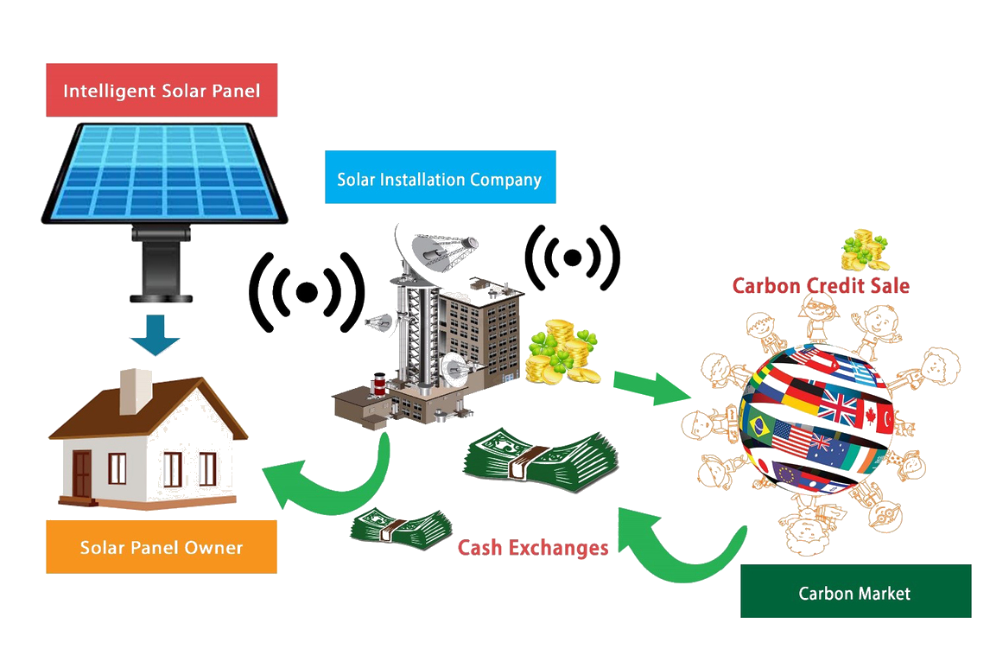

Slide 9
Use of Intelligent Solar Panels to Facilitate Carbon Trading
The End

